Slide 1
St Adrian’s Catholic Primary School PTA
28th June 2023
Notes:
Hello and welcome to everyone

Slide 2
The PTA Committee
Donna Cristofoli
Co-Chair
Y2
Emma Smith
Co-Chair
Y2 and nursery
Joh Murphy
Secretary
Reception
Treasurer
?
Committee Members:
Mrs Porter (Head) Louise Giles
Laura Donnellan Victoria Fitzgerald Lauren McEvoy Jessica Horwood Joh Murphy Mhari-Louise Heal Vanessa Keane Katarzyna Pelc
Volunteers:
Denise O’Leary – Christmas cards
Katy Watts- Second-hand uniform
Notes:
Caroline and I took on our roles when we still had Rachel as acting chair, so we have been doing the best we can keeping everything going as we learn about running the PTA.
The committee are an amazing team – there are old timers and there are newbies and we would like to say a massive thank you to all of them for their support and enthusiasm.
Donna, thank you for taking over kindly taken over from Denise on uniform, and Denise – a glutton for punishment, thank you for all the work you have done over the years on uniform, and for now taking on the Christmas cards instead!
Claire thank you for keeping those going for so long and for helping Denise learn the ropes this year before you go!
Collette – thank you for sorting out the panto, I for one can’t wait!

Slide 3
What is the PTA?
A PTA is a group of volunteer parents and teachers who work together to make their school a better environment for children to learn. They raise extra funds through a wide range of fun and creative initiatives, events, and much, much more.
The average PTA raises £9,000 each year to pay for things that school budgets cannot stretch to.
When your children join the school, you, as parents automatically become a part of the PTA. You are able to attend any open meeting, help out at or turn up to school events, and get involved – even if you aren’t PTA committee members. Everyone leads busy lives and it is up to you how much time you give. Many hands make light work!

Slide 4
How can I get involved?
Attend PTA meetings
Volunteer in person at fundraising events
Volunteer to run an event of your own
Donate/collect prizes, bake cakes, buy/sell raffle tickets
Become a Class REP to communicate messages
Join us on the committee- we are looking for a treasurer!

Slide 5
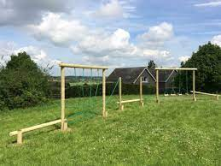
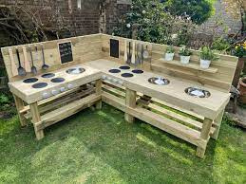
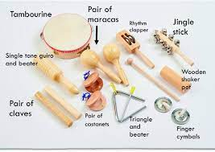
Headteacher Wish List
TRIM TRAIL
Key stage 2 playground
£6-12,000
IPADS
£4000
Mud Kitchen
EYFS
£2000
Percussion Instruments
£500
Notes:
CAROLINE You are all aware I’m sure about the amazing transformation going on in the infants playground. This is thanks to all the funds that have been raised so far, but we will still be paying for it for a while so there is more work for us to do! There are also various other things the PTA contributes to…
In total through out the year we raised approx £11k - the main money makers were Hampers (Christmas and Summer) which between them raised £4k, Smarties challenge raised £1.3k, School Lottery £1.6k, Movie afternoons £700 and Mufti £700
Main expenses were Maths No Problem and Wifi which were approx £5k in total

Slide 6
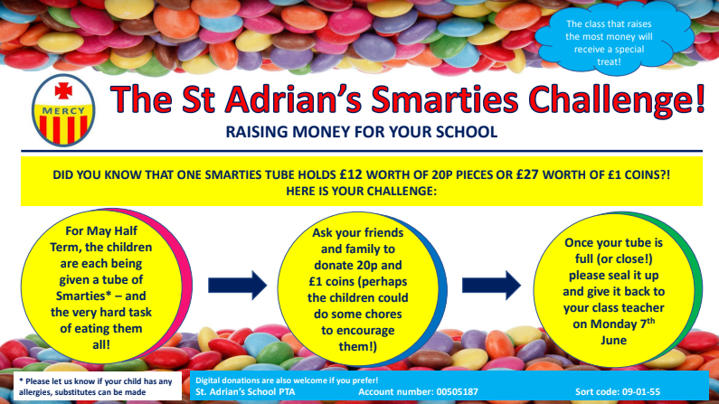
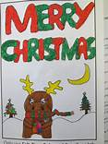
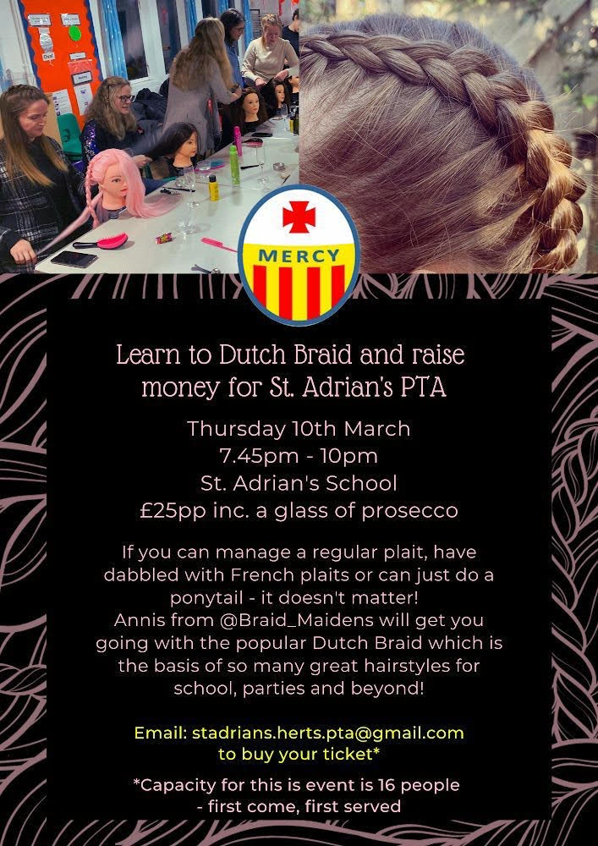
What did we get up to 2022-2023?
Sponsored Bounce
Notes:
CAROLINE as we navigate the ‘back to normality’ coming out of Covid, we have had brilliant opportunities to hold events and fundraising challenges which have been a huge success.
You can see here how much each endeavour has raised and though they have been scaled back from pre-Covid, and we are having to think smarter and run things more minimally without a chair, they are still raising lots of funds for our school.
TALK THROUGH YOUR NUMBERS

Slide 7
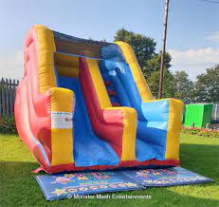
Our Summer BBQ is on the 15th July which you are all welcome too. It would be wonderful to see some new faces!
12.30pm - 3.30pm
Notes:
Much like the BBQ, where we had to think outside the box a bit, rather than try to recreate the summer fairs of old, we hope to have similar success with our ‘different version’ of Christmas!
The old Christmas Fair really was a labour of love and we were so lucky to have Rachel and her elves working round the clock to make that work. This year again we are trying to keep the fun, keep the spirit, but slightly scale back the level of work required from all involved. The Christmas Party seemed like a great way to keep all the things we love, keep the kids entertained, give us a chance to get our glad rags on and come together as a community.
We will be looking for volunteers for the stalls here and no doubt there will be work to do in the run up to the event (stuffing sweet bags for example!) but we will keep in touch with everyone via class reps on what we need from you.

Slide 8
Non-Event Fundraising
Easyfundraising has partnered with over 7000 brands! They donate part of what you have spent to your chosen charity.
PTA number: 18528
15% purchase towards St Adrian’s
PTA code: AL1 2PB
Katy Watts
Notes:
It’s more important than ever for us to keep the non-event fundraising working in the background. These are some of the things we have already got up and running and maybe it’s worth a reminder via the class reps how you access these? We can provide.
You can see here I’ve got local businesses, Laura and Rachel are doing a great job in thinking about businesses to approach to make a straightforward donation to the cause (we can of course publicise them on our facebook, school newsletters and through whatsapp groups etc if that helps!) – they have good lead with Phillimore Community Centre - waiting to hear what they can do for us!
It was amazing to get the 50 Club filled up, this makes the PTA £3K without any activity except the drawing of the number each month.
There have been other ideas in the past such as a recipe book – too late for Christmas now but could look to have them ready for sale by Mothers Day? Facebook 2nd hand sales group was another idea if anyone could support that. Any more for any more?

Slide 9
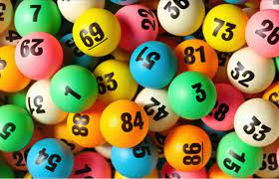
Non-Event Fundraising
Join our 50 Club!
Notes:
It’s more important than ever for us to keep the non-event fundraising working in the background. These are some of the things we have already got up and running and maybe it’s worth a reminder via the class reps how you access these? We can provide.
You can see here I’ve got local businesses, Laura and Rachel are doing a great job in thinking about businesses to approach to make a straightforward donation to the cause (we can of course publicise them on our facebook, school newsletters and through whatsapp groups etc if that helps!) – they have good lead with Phillimore Community Centre - waiting to hear what they can do for us!
It was amazing to get the 50 Club filled up, this makes the PTA £3K without any activity except the drawing of the number each month.
There have been other ideas in the past such as a recipe book – too late for Christmas now but could look to have them ready for sale by Mothers Day? Facebook 2nd hand sales group was another idea if anyone could support that. Any more for any more?

Slide 10
How do you contact us?
Main Parent Facebook Group www.facebook.com/groups/stadriansparents
PTA webpage http://stadrians.herts.sch.uk/pta/
And watch out for your class rep WhatsApp groups!

Slide 11
Thank you for your time!

