Slide 1
Welcome to St. Adrian’s Reception
‘To learn, to love, to live’

Slide 2
Useful Documents

Slide 3
Daily Routines
Arrival and registration Busy fingers activities Little Wandle Learning Through play/ Snack time Adult led activities (Maths, RE, HW, Art, English) Story time Lunch time Registration/Singing time Adult led activities (Maths, RE, HW, Art, English) Guided reading Learning Through Play Story time Home Time

Slide 4
Arrival Routines
A member of staff will be on the door to welcome you. Please give us any
brief messages at this point- if your child is going home with someone else,
if they have had a bad night, etc. We will note this in our diary. Alternatively
you can the office know.
Say goodbyes- one kiss, one hug usually works well!
Every Friday you are welcome to stay and share a story with your child.
We discourage the children from bringing toys into nursery- lost/ damaged.
Appreciate they may need a comfort toy at the beginning/ at a random time- whatever suits the individual child.
DON’T WORRY- all children eventually settle, and most do so within a short time after you’ve left. We will call you to let you know how they are if they have found it hard to leave you. It usually helps if you let a member of staff help and take over, even though it may be hard for you.

Slide 5
Collection Routine
We will make a list of people who will collect on a regular basis,
and your child will be instantly dismissed to these people.
Please tell us of any changes in the morning- if you don’t, we won’t let your child go home until we have telephoned you.
Changes that happen last minute- traffic- please call the school office.
2 members of staff will be dismissing the children, to ensure safety and to pass on any messages.
PLEASE BEAR WITH US AS SAFELY DISMISSING ALL THE CHILDREN CAN TAKE TIME.

Slide 6
Sickness/Medicine
Sickness/ diarrhoea: Please keep your child
off for at least 48 hours after their last episode.
Please let us know about any allergies/ inhalers etc.
You know your child- send them in with mild coughs/ colds- we will call you if very under the weather

Slide 7
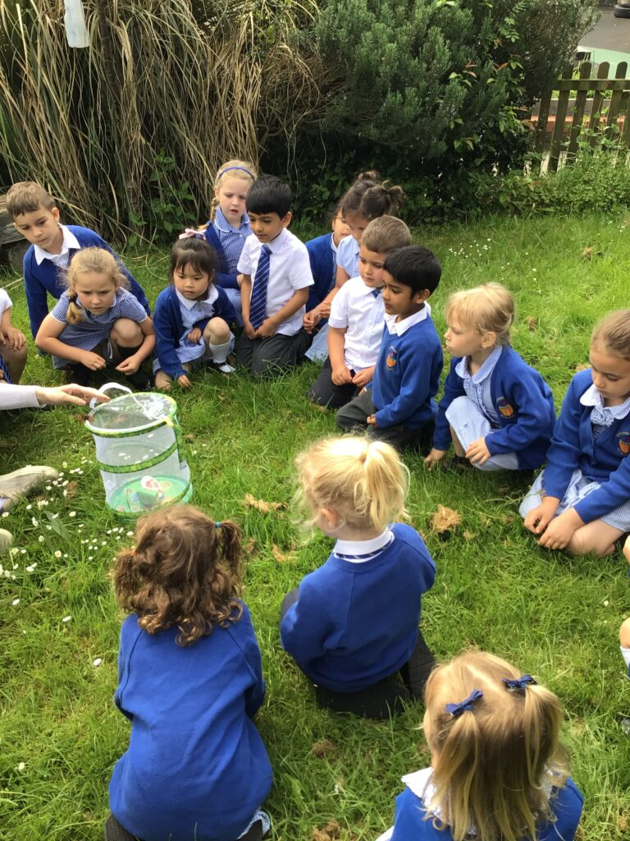
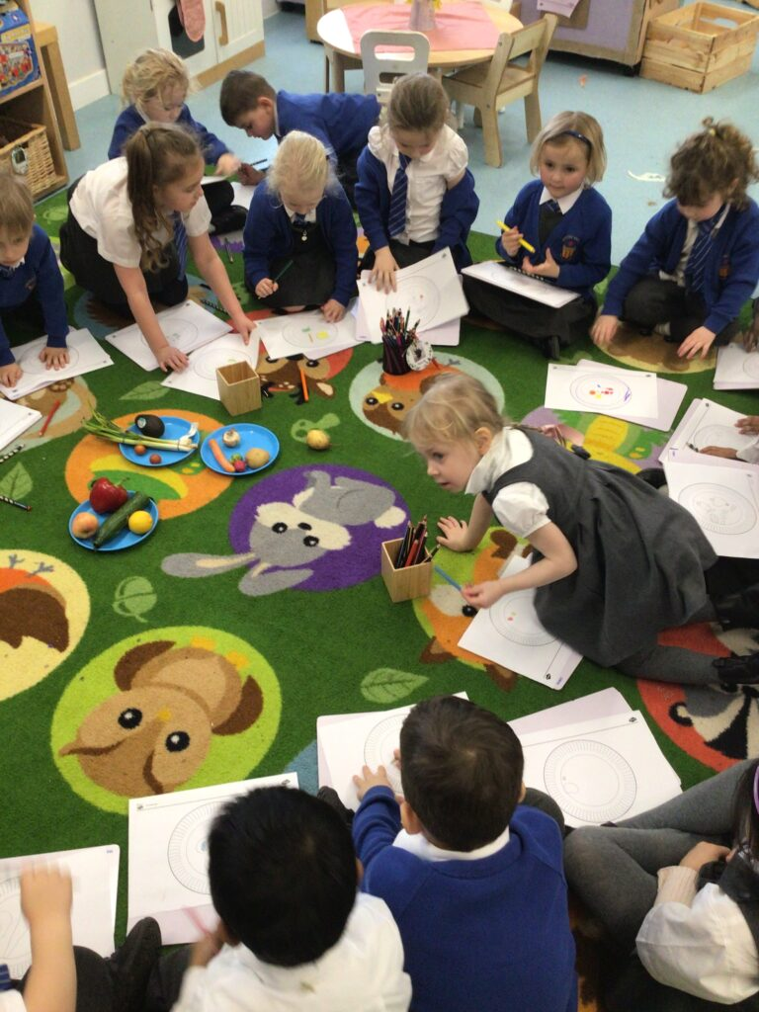
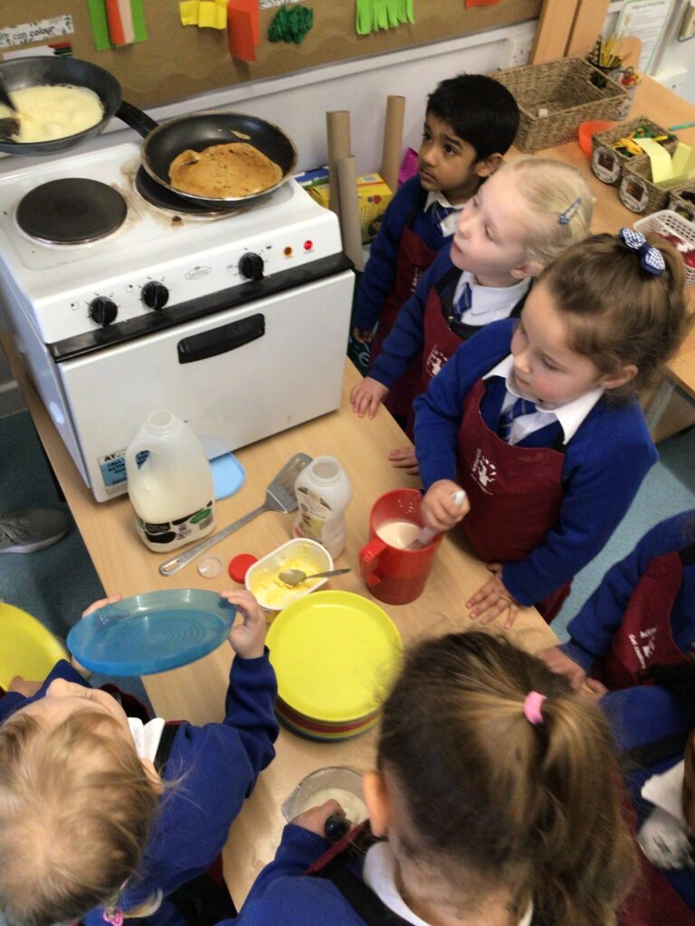
Adult led activities
Approx 20-25 mins
Pre chosen skills based activities that all children get the chance
to take part in
Could be in any area of the curriculum and classroom- indoor or outdoor- small groups or whole class

Slide 8
Little Wandle / White Rose

Slide 9
Learning Through Play - LTP
At least an 1 hours per session
Free flow- indoors and outdoors
Children choose what they would like to do from the equipment always available to them, and things that we have put out to coincide with a theme etc.
Staff play alongside, observe and support the children

Slide 10
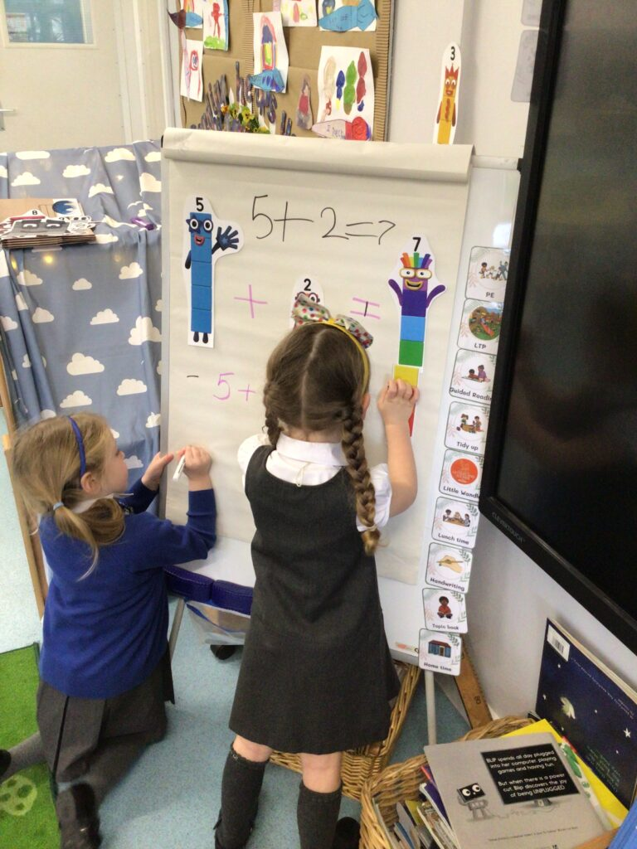
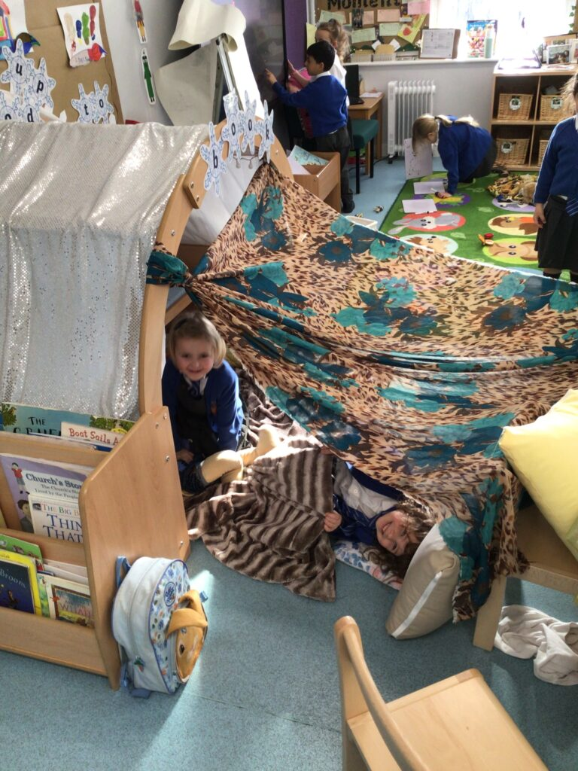
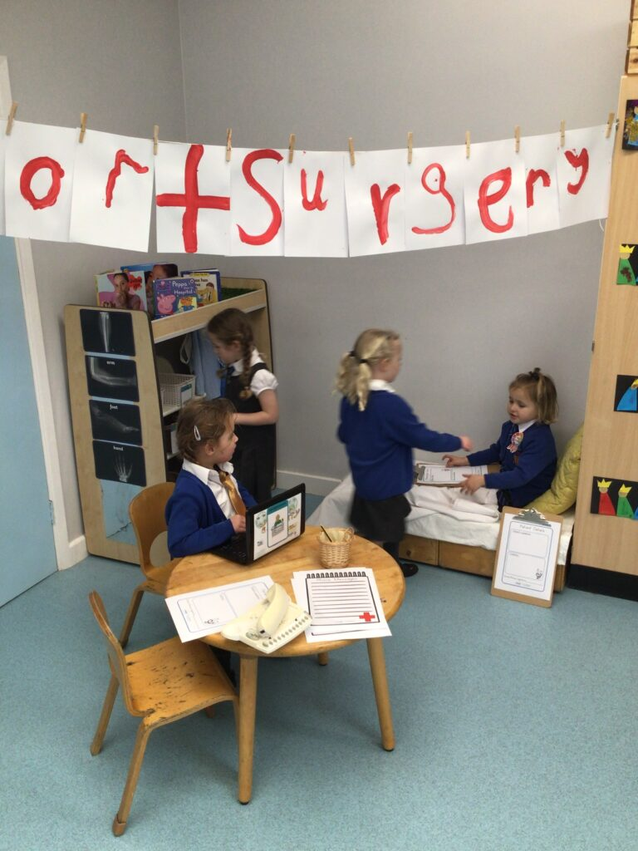
Learning Through Play - LTP

Slide 11
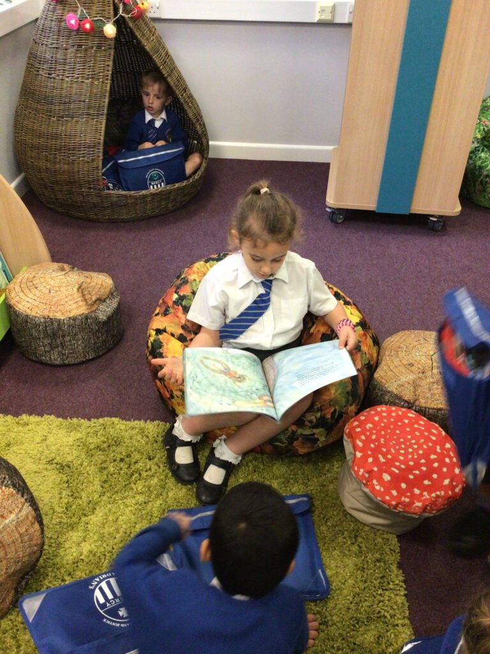
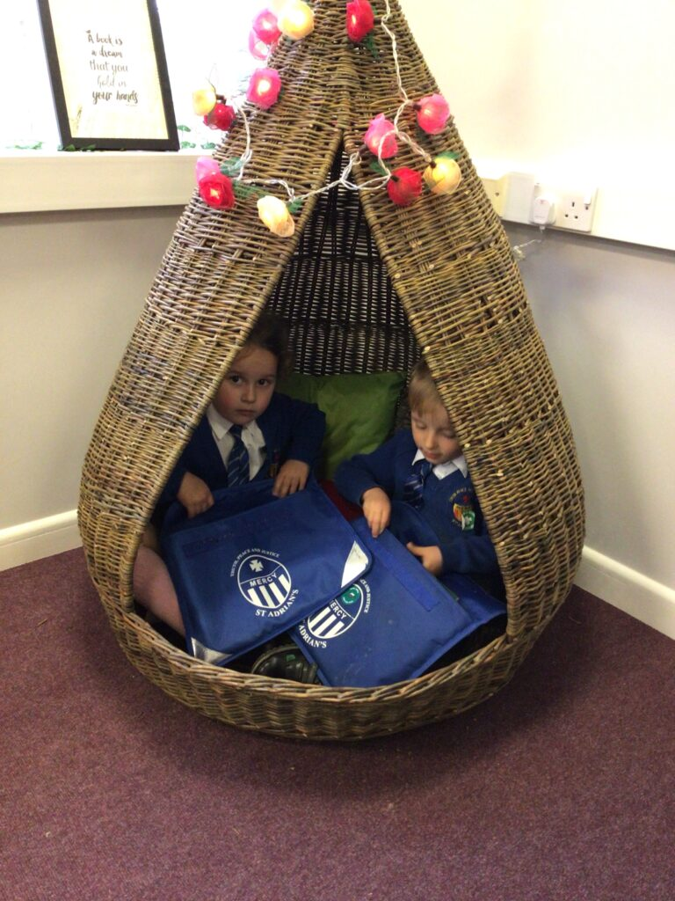
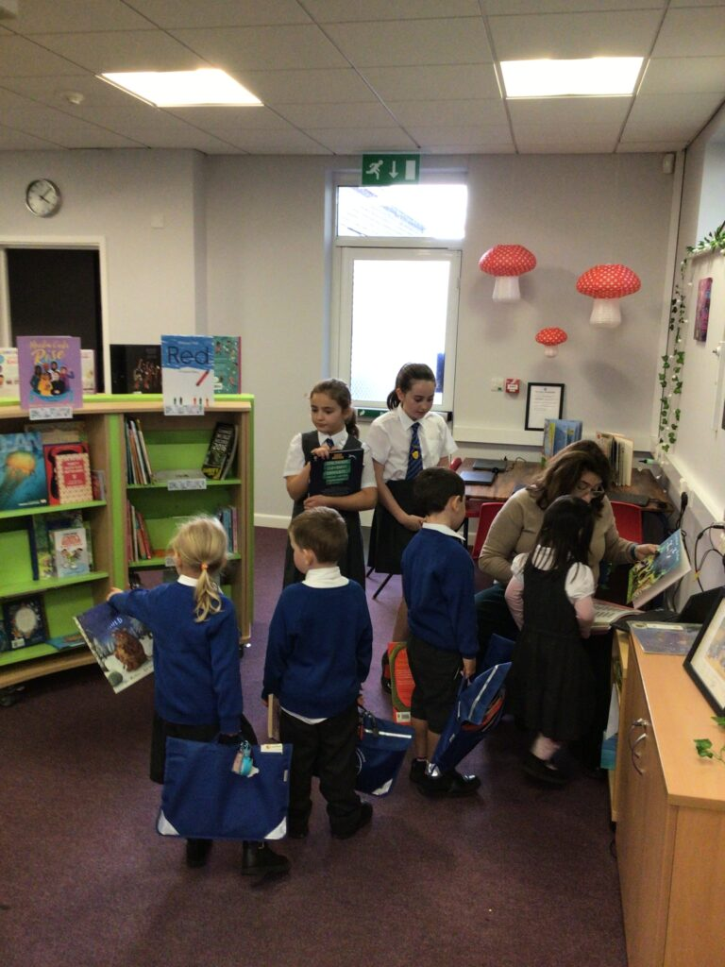
Library
Once a week the children will visit the school library and change their library book. Please make sure their old book is in their book back, because we might not be able to issue a new one.

Slide 12
Uniform
Good sensible school shoes for running and climbing- we don’t have
separate indoor shoes
Shoes that can be put on and off independently are ideal e.g. velcro,
no shoe laces.
We will go out in the cold and drizzle- raincoats.
Wellies.
PE kit
Winter Uniform - School jumper, white shirt and tie; Grey dress/trousers.
Summer Uniform - White shirt and tie/grey shorts. Summer dresses. In a very hot weather you can wear white polo shirt without the tie.

Slide 13
Characteristic of effective learning
Playing and exploring
Children investigate and experience things and “have a go”.
Active learning
Children concentrate and keep on trying if they encounter difficulties and enjoy their achievements.
Creativity and thinking critically
Children have and develop their own ideas and make links between ideas, and develop strategies for doing things.

Slide 14
Learning and Developing
Seven areas of learning:
Prime:
• communication and language
• physical development
• personal, social and emotional development
Specific:
• literacy
• mathematics
• understanding the world
• expressive arts and design

Slide 15
How we communicate with you?
Communication is so important. It plays a huge role in ensuring that you are regularly sharing information with us to best support your child.
We do this by…
Contact with class teachers
Parent consultation meetings
Text notifications/reminders
Newsletters
Email - admin@stadrians.herts.sch.uk
Arbor and School Gateway
School website and class blog http://stadrians.herts.sch.uk
Social Media – Facebook, Twitter - links on school website
Tapestry – online learning journal

Slide 16
Question time
No question is a silly question…
If anyone has anything they would like to ask please feel
free to do so.
If you have any questions personal to your family there will be an opportunity to ask these at a specially arranged meeting.

