Slide 1
British Values at St Adrian’s

Slide 2
We are learning to
Understand that rules help us to stay safe and happy
Democracy
Individual liberty
Mutual respect
Tolerance
Rule of law

Slide 3
But what do we mean by ‘British’?

Slide 4
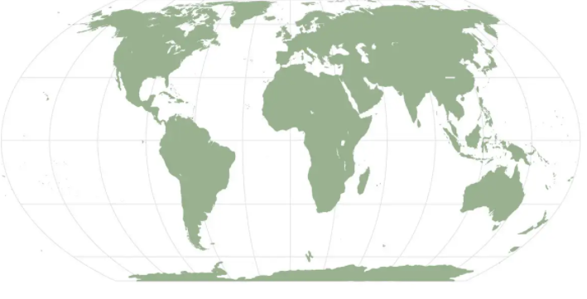
What and where is Britain?
BRITAIN
USA
EUROPE
AFRICA
ASIA and OCEANIA
SOUTH AMERICA
Notes:
British = relating to Britain and its people.

Slide 5
And what do we mean by ‘values’?

Slide 6
“Your values are the things that you believe are important in the way you live your life.”
— definition of ‘values’ from Mind Tools

Slide 7
British
‘British’
Relating to Britain, its people or its language.
‘Values’
The set of beliefs that guide how you live your life.
Values
Democracy
The way we take part in making decision about how things are run.
Democracy 01
Mutual Respect 02
Mutual Respect
We have respect for ourselves and others.
Mutual Respect
Individual Liberty
Freedom comes with responsibility.
Individual Liberty 03

Slide 8
What rules do you have at home or at school?

Slide 9
Wouldn’t it be great if we didn’t have any rules? What do you think?

Slide 10
Video

Slide 11
What happens if you break a rule at Amelie and Daniel's school?

Slide 12
Who started a campaign on a bus to change laws in America that treated black people unfairly?

Slide 13
What did Judge Tan Ikram say that the role of a judge is?

Slide 14
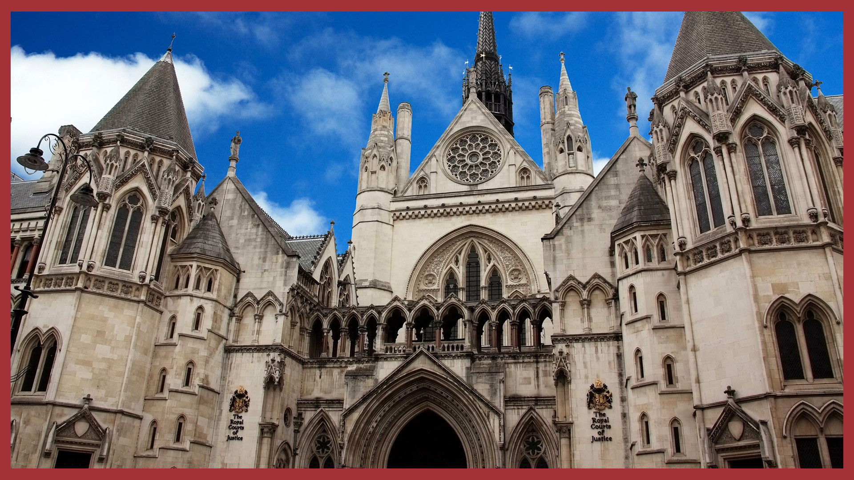
Notes:
How do you feel about rules and laws now?
What is the building that Daniel says 'looks like something out of Harry Potter'? (The Royal Courts of Justice - see 'Key links' for an image)

Slide 15
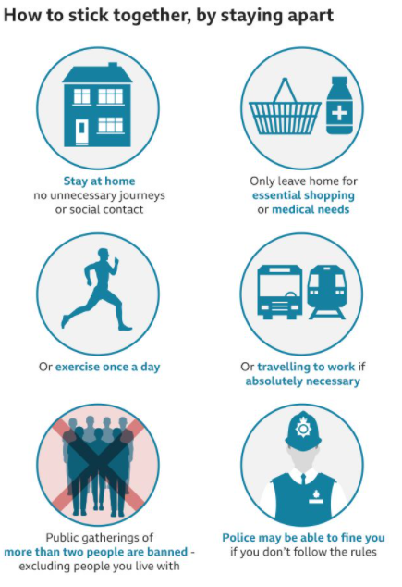
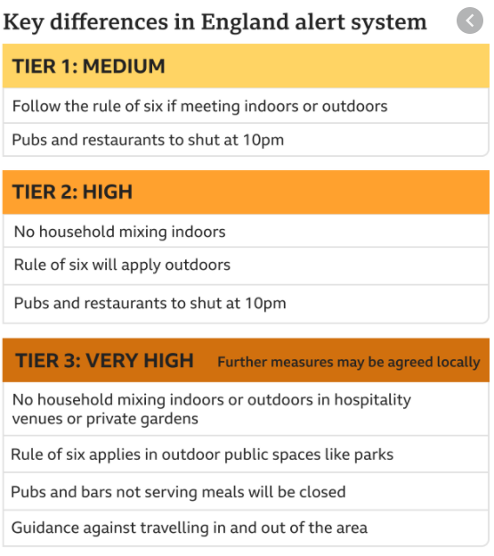

Slide 16
If you could make up a rule or law, what would it be?
Notes:
Who needs rules 2

Slide 17
Reflection
The rules we make keep us safe and help us live and learn…
Without them, life would be unfair…
What can you do to make sure everyone is treated fairly?

Slide 18
Prayer
Dear God,
We thank you for the rules and laws that keep us safe and treated fairly. Help us to value and respect them and to treat others fairly. Especially now, with
Amen

Slide 19
https://forms.gle/CigHKyuS2iZn2hvv6
Quiz

