Slide 1
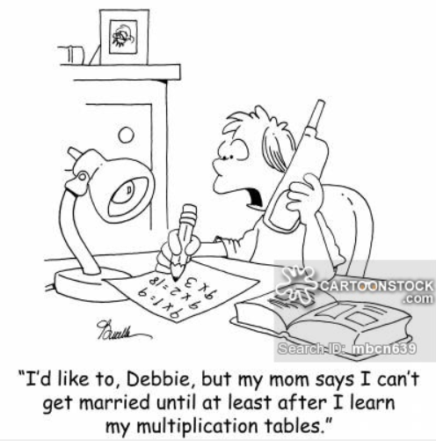
Welcome! Times tables fluency- Parent Workshop.
St Adrian’s Catholic Primary School

Slide 2
What we hope you will get out of this workshop…
1. A clear understanding of how your child will learn times tables.
2. Opportunity to practice ways of helping your child.

Slide 3
Multiplication Tables Check
A statutory ‘check’ that all year 4 pupils will take from 2020 to determine whether they can fluently recall multiplication facts.
It will consist of 25 questions set at 6 second intervals and will include all times tables up to 12 x 12.
There will not be a pass mark and results will only be shared with the school and certain organisations such as Ofsted.

Slide 4
Major milestones
Year group | Times tables
1 | Solve simple multiplication and division using objects, pictures and arrays with support
2 | 2, 5 and 10
3 | 3, 4 and 8
4 | All times tables up to 12 x 12
Notes:
Difference between counting in multiples and knowing times tables i.e. in Year 1 pupils will count in multiples of 2, 5 and 10.

Slide 5
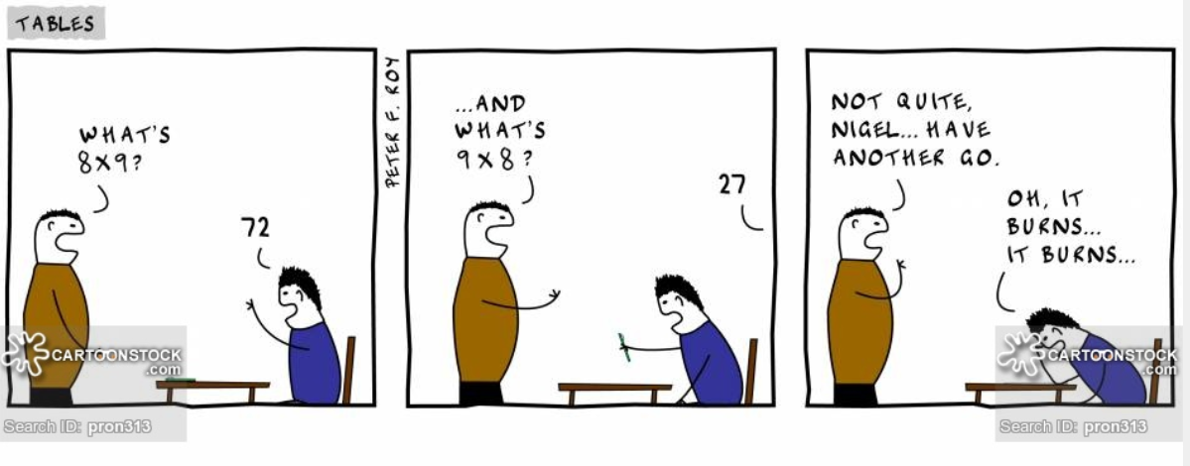
Notes:
While we are aiming for instant, memory recall, we feel it is important that this is developed alongside a deep and secure understanding of the maths involved which we believe the process we are using will achieve.

Slide 6
So how are we developing fluency?
Type this into your browser and have a go.
http://bit.ly/MTCGAME
Assess
Teach
Practice
Notes:
Open a separate window and type in the url on the slide (case sensitive) – it’s trickier on a mobile phone. Set parameters to 5 questions and fewer seconds.
Explain how we are using this.
To ascertain which table to start with
To identify any focus groups
To establish a ‘baseline’ from which the impact of what we are doing can be measured
Parents to have a go – point out that they can change parameters.

Slide 7
So how are we developing fluency?
Assess
Teach
Practice
Learning the facts
(the teaching bit)
Notes:
Often we think that rehearsing, recalling and assessing is all that is needed to help children gain fluency.
However, it is this bit – the teaching – that is missed and is the most important bit we do.

Slide 8
Learning the facts
Notes:
Make me 1 group of 4 cubes. Everybody show me. Now, just like me, write the number fact that links to that. 1 x 4 = 4.) – leave space for arrays
This is 0 x 4 (Show parents my empty hand) – how many do I have in my hand? None – we do this after 1 x 4 to help children grasp the concept of 0 x more easily.)
Next, make a second group of 4 cubes/counters. Now we have 2 groups of 4 (2 x 4). Write the fact and place the cubes next to it. Check as you go that you have made and recorded the correct answers.
Continue to build the array, adding a row each time and recording the corresponding fact made until 12 x _
In front of you now you should have a full set of facts. With your neighbor, rehearse and check in order from 0 x to 12 x – forward then backwards – do the answers go up in equal steps of 4? Have your groups stayed the same size each time (i.e. four cubes) and have the number of groups gone up by 1 each time?
Great – now, we are going to record the arrays alongside written facts to help us to create a recall memory for these facts.
What this has done is to have given you (your child) a really clear process to see what the 4 times table actually looks like – we’ve used concrete resources (cubes/counters), abstract (the written facts) and pictorial (the arrays) to help with this.
Pre-step
Use bead string – use speaking frame: counting in multiples – repeated addition, grouping, multiple, times table fact. Think about language.

Slide 9
So how are we developing fluency?
Assess
Teach
Practice
Practice
(making and playing games with made cards)
Notes:
Pupils then create card games to rehearse facts. (Child write the fact and answer – their own set of cards.)

Slide 10
Games with the cards
On your own, in a pair, or with an adult…
In order first, with the list still visible
In order, without the list
Starting with the product, give the fact
Out of order – choose ‘easiest’ first
Out of order – shuffled / random
Speed round
When playing, they should say the whole fact.
Notes:
Pupils will need 13 small rectangles of card to write the question on the front and answer on the back, from 0 x _ up to 12 x _
Pupils to make them themselves. - landscape
When playing they should say the whole fact.
Ultimate goal is to know my memory/off by heart.
Which game you play will depend on how well your child knows that particular times table.
Publish on blog – sheet for each table
Have a go!

Slide 11
Games with the cards
Take turns: take turns to choose a card and say the answer to the calculation. If correct, keep the card in your pile until all cards are gone.
Switched: play as above but mix cards so that the answers are face up. You have to say the calculation for these.
Mix up: play as above but mix cards so that some answers are face up. You have to either give the correct answer or calculation.
Speedy (in order): use the cards in order to say the answer to the calculation on each card as quickly as possible. Check the answer on the back.
Speedy (out of order): as above, but the cards can be in any order.
Notes:
Some other variations.

Slide 12
So what can you do at home?
Notes:
If your child is finding the games tricky and is not getting it then go back to building the arrays – follow the same process we have used today with whatever you can find around the house.

Slide 13
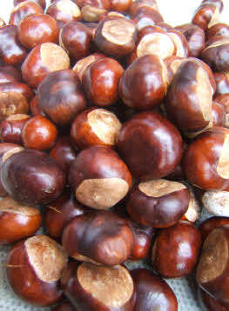
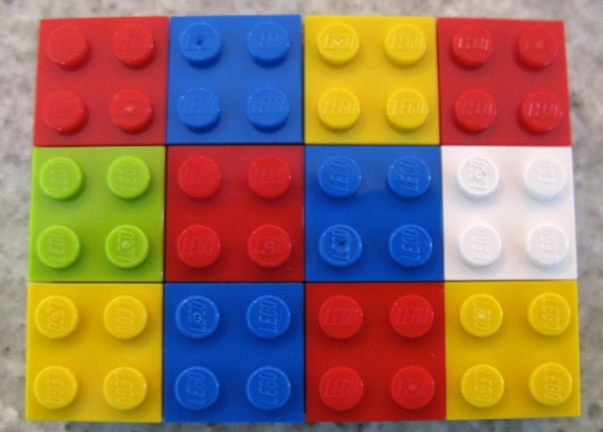
… Conkers … LEGO

Slide 14
Learning the facts
Start with 1 x _
Make the array
Clarify 0 x _ = 0
Write the list
Check it – forwards, backwards, out of order

Slide 15
Recall strategies
Notes:
If they are generally getting it but stuck on a few tricky facts then try some of these strategies.

Slide 16
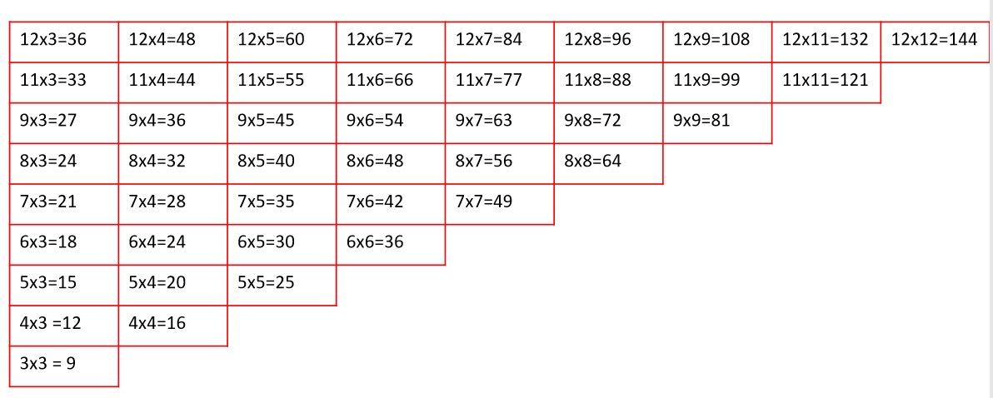
Target Zone – 45 facts

Slide 17
Has it worked?
Assess
Teach
Practice
We will then re-assess using the same tool.
http://bit.ly/MTCGAME
Notes:
Explain how we are using this now.
Have children gained fluency?
What next?
Within all of this – still recap.

Slide 18
What we’ll publish…
Current times table on blog.
Suggested games and activities published alongside these.
A ‘building arrays’ crib sheet for each times table will also be made available.

Slide 19
St Adrian’s Catholic Primary School
Thank you

