Slide 1
Diary dates
Welcome to year 6
Friday 26th October 2018 – Y6 assembly
WB 13th May 2019 - SATs week
Monday 20th May 2019 – Isle of Wight

Slide 2
Staffing
Teaching staff
Mrs May
Mr Sallis
Mrs Butterworth
Mr King
Support staff (including booster sessions and guided reading)
Mrs Robins
Miss McCarthy
Mr Silver
Mrs Butterworth

Slide 3
General
P.E kit – Mondays and Tuesdays
Musical instrument lessons – Tuesdays, Wednesdays and Thursdays
Reading records in school every day
Homework set on a Friday, due the following Wednesday

Slide 4
School blog…
http://stadrians.herts.sch.uk/

Slide 5
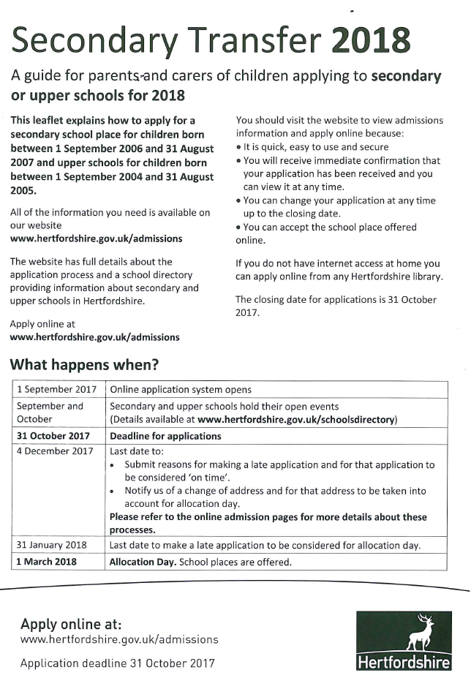
www.Hertfordshire.gov.uk/admissions

Slide 6
Writing

Slide 7
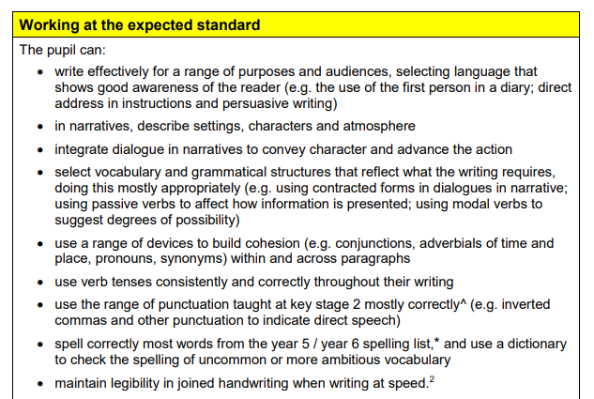
Writing

Slide 8
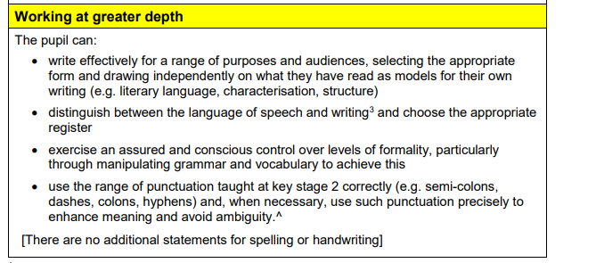
Writing

Slide 9
SATs
Week beginning Monday 13th May 2019
National Curriculum assessments are the statutory assessments carried out in primary schools in England.
The assessments are made up of a combination of testing and teacher assessment judgements, and are used in all government-funded primary schools in England to assess the attainment of pupils against the programmes of study of the National Curriculum at the end of Key Stages 1 & 2.

Slide 10
What form will the tests take?
English
Reading (1 hour test, including reading time)
Grammar and punctuation (45minutes)
Spelling (approx. 15minutes)
Maths
Arithmetic (30minutes)
Reasoning A (40 minutes)
Reasoning B (40 minutes)

Slide 11
Teacher assessment
Writing will be teacher assessed over the course of the year, across all subjects.
Science will be teacher assessed, however there is a chance we could be selected for test sampling. This involves a select numbers of children being assessed in the three areas of science.

Slide 12
How can you help?
Encourage your child’s independence
Ask them about their day
Let them take responsibility for their work and actions
Ensure there is a calm, quiet environment for homework
Ensure that time is organised within the family ‘routine’ for school work
Bedtime routine
Healthy lifestyle

Slide 13
Any questions?

