Slide 1
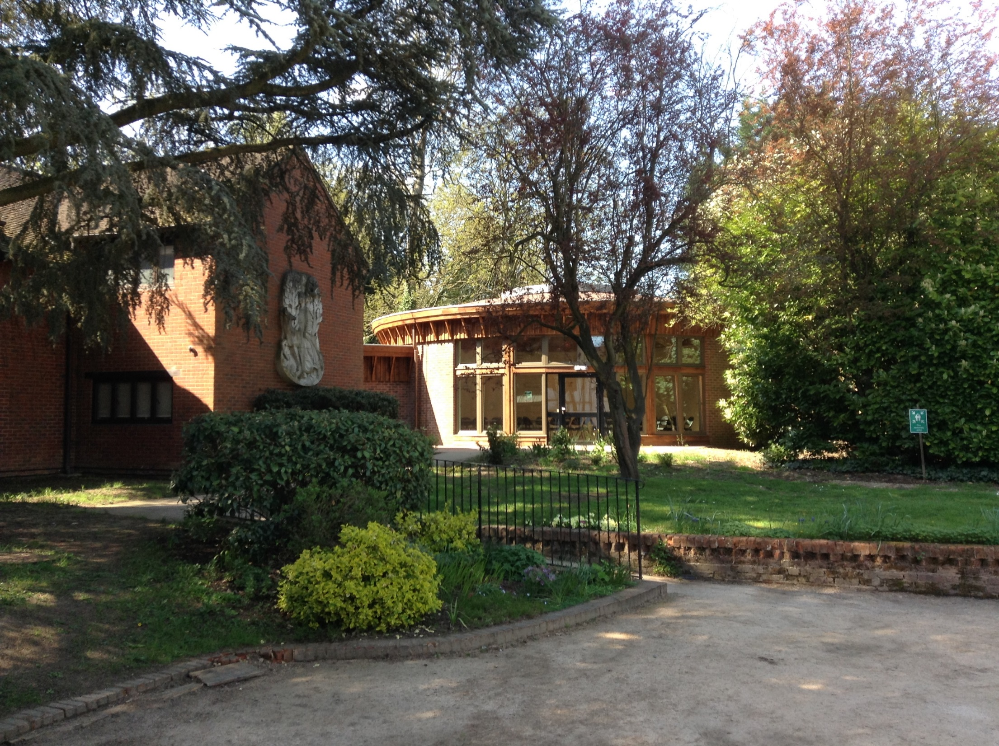
SPEC VISIT
SPEC VISIT
9th May 2018 –Friday 11th May 2018

Slide 2
The Purpose
Called by name:
Meditations
Role play
Mass (and preparation)
Drama
Campfire
Team-work activities

Slide 3
Timings
Leave St Adrian’s at 9:00 am to arrive around 10:00
Leave the SPEC Centre (Waxwell Lane , HA53EP) at 2:30 pm on Friday to arrive at school around 3:15 pm

Slide 4
The accommodation

Slide 5
Ablutions

Slide 6
Dining

Slide 10
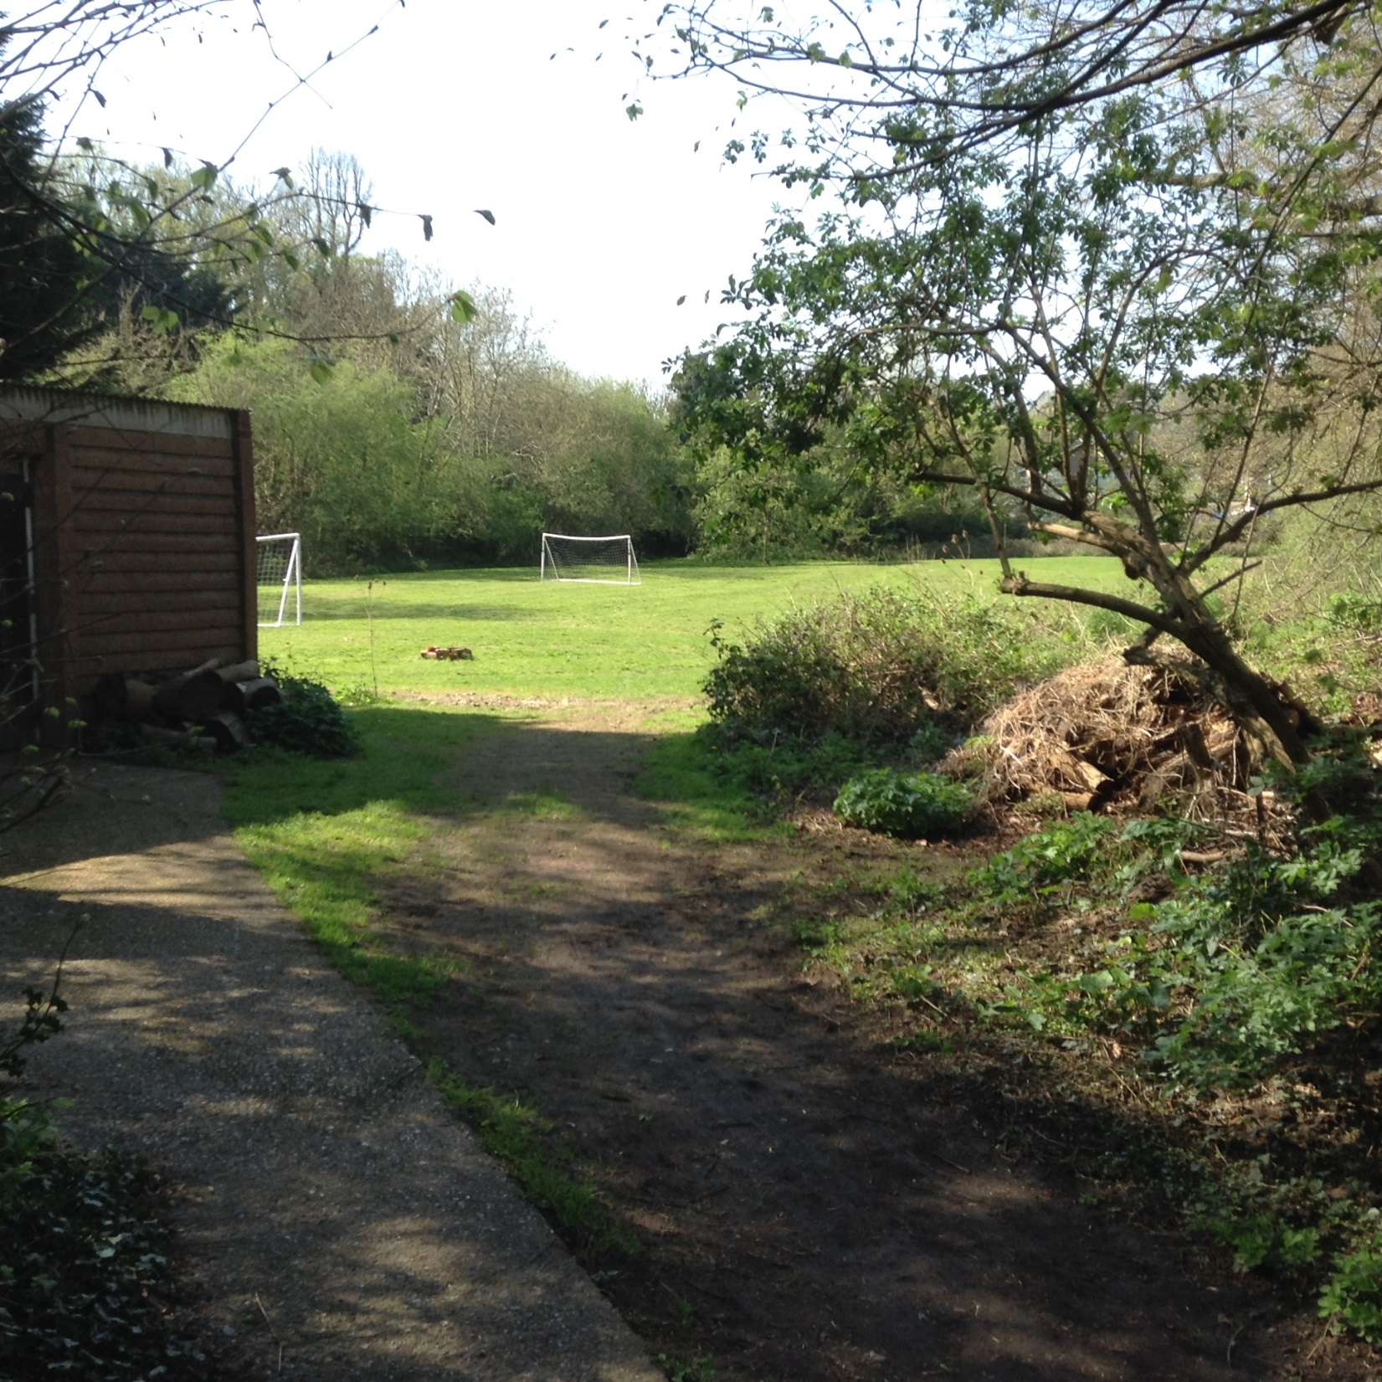

Slide 15
Safety and Security
Fire precautions –
Intruders-
The grounds
Illness / medicines / emergency contact numbers/
The grounds /buddy system

Slide 16
Rules
Bed by 8:30 (Lights out at 9:00) subject to local conditions
At least 2 in the shower room.
( 1 shower each )
Tidy and help
No technology to be brought (except digital cameras)
DVDs ok
NO NUTS
No sweets / snacks*

Slide 17
What to bring
SPEC Residential groups: what to bring...
Clothing in context
You will have a retreat that includes a mixture of indoor and outdoor activities. We suggest that you leave your designer clothes and new trainers at home, and bring comfy clothes that you do not mind getting wet or muddy.
It is important that your outdoor clothing is warm and waterproof as your retreat may
include a camp fire, a night walk, or both!
The following is not an exhaustive list, but covers what we consider to be essentials:
* Wash kit (soap, toothbrush, toothpaste, shower gel)
* Indoor shoes (slippers)
* Outdoor shoes (that you don’t mind getting muddy/dirty)
* Plenty of socks
* Underwear
* Outdoor trousers – warm ones that you don’t mind getting dirty
* Warm layers – fleeces, coats, jumpers
* Waterproof jacket
* Warm hat and gloves – if the weather turns cold
Sun cream
Bed linen and towels will be provided by SPEC.
No electronic devices except digital cameras.
A book and possibly playing cards/ top trumps etc/ DVDs

Slide 18
Other
Diet –
Any other circumstance
Ascension day.

