Slide 1
Diary dates
Welcome to year 6
Friday 20th October – Y6 assembly
WB 14th May 2018 - SATs week
Saturday 19th May 2018 – Isle of Wight

Slide 2
Staffing
Teaching staff
Mrs May
Mr Bedford
Support staff (including booster sessions)
Mrs Wastell
Miss McCarthy
Mr Silver

Slide 3
General
P.E kit – Tuesdays and Thursdays
Musical instrument lessons – Wednesdays
Reading records, spelling books in school every day.
Homework set on a Friday, due the following Wednesday.

Slide 4
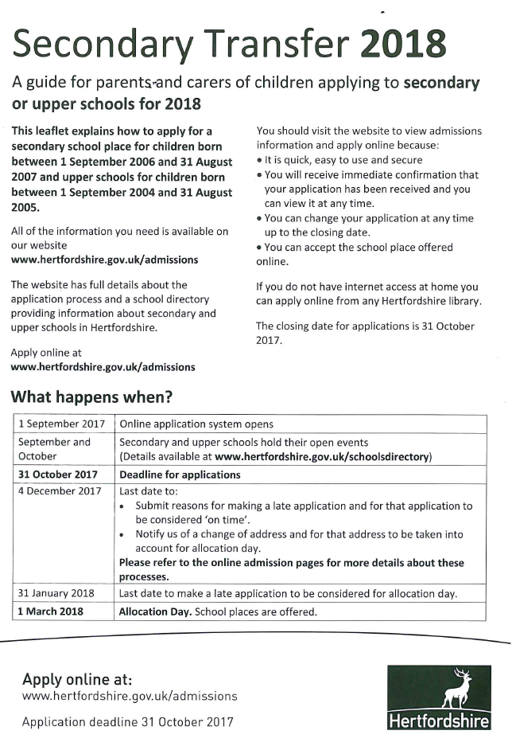

Slide 5
Writing
Y6 grammar glossary
Expectations
Teacher assessment (ITAFs)
Going back to basics

Slide 6
SATs
Week beginning Monday 14th May 2018
National Curriculum assessments are the statutory assessments carried out in primary schools in England.
The assessments are made up of a combination of testing and teacher assessment judgements, and are used in all government-funded primary schools in England to assess the attainment of pupils against the programmes of study of the National Curriculum at the end of Key Stages 1 & 2.

Slide 7
What form will the tests take?
English
Reading (1 hour test, including reading time)
Grammar and punctuation (30minutes)
Spelling
Maths
Arithmetic (30minutes)
Reasoning A (40 minutes)
Reasoning B (40 minutes)

Slide 8
Teacher assessment
Writing will be teacher assessed over the course of the year, across all subjects.
Science will be teacher assessed, however there is a chance we could be selected for test sampling. This involves a select numbers of children being assessed in the three areas of science.

Slide 9
How can you help?
Encourage your child’s independence
Let them take responsibility for their work and actions
Ensure there is a calm, quiet environment for homework
Ensure that time is organised within the family ‘routine’ for school work
Bedtime routine
Healthy lifestyle

Slide 10
Any questions?

